Slide 1
PART IV
Network Layer

Slide 2
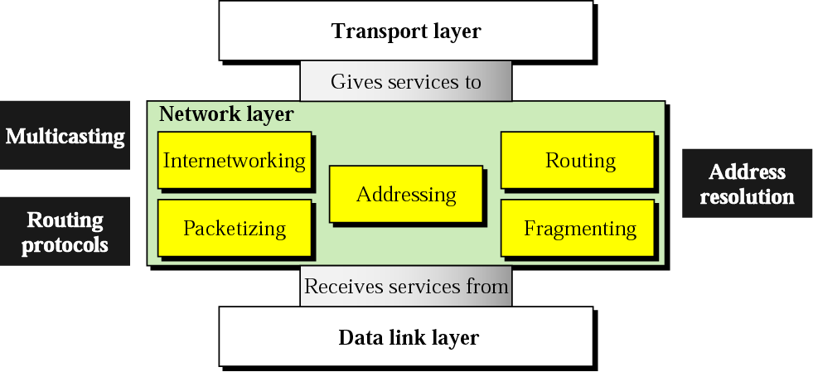
Position of network layer

Slide 3
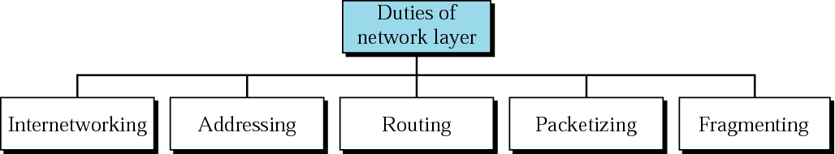
Network layer duties

Slide 4
Chapters
Chapter 19 Host-to-Host Delivery
Chapter 20 Network Layer Protocols
Chapter 21 Unicast and Multicast Routing Protocols

Slide 5
Chapter 19
Host-to-Host
Delivery:
Internetworking,
Addressing,
and Routing

Slide 6
19.1 Internetworks
Need For Network Layer
Internet As A Packet-Switched Network
Internet As A Connectionless Network

Slide 7
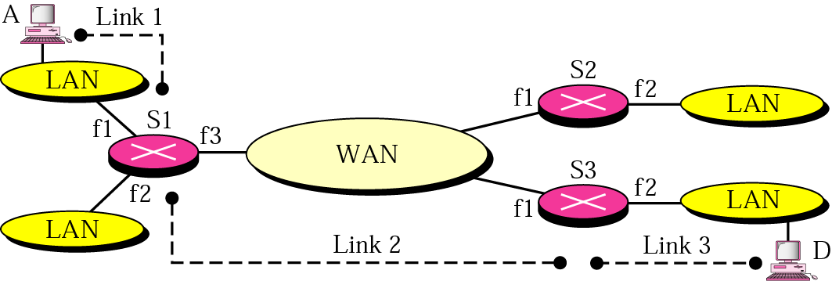
Figure 19.1 Internetwork

Slide 8
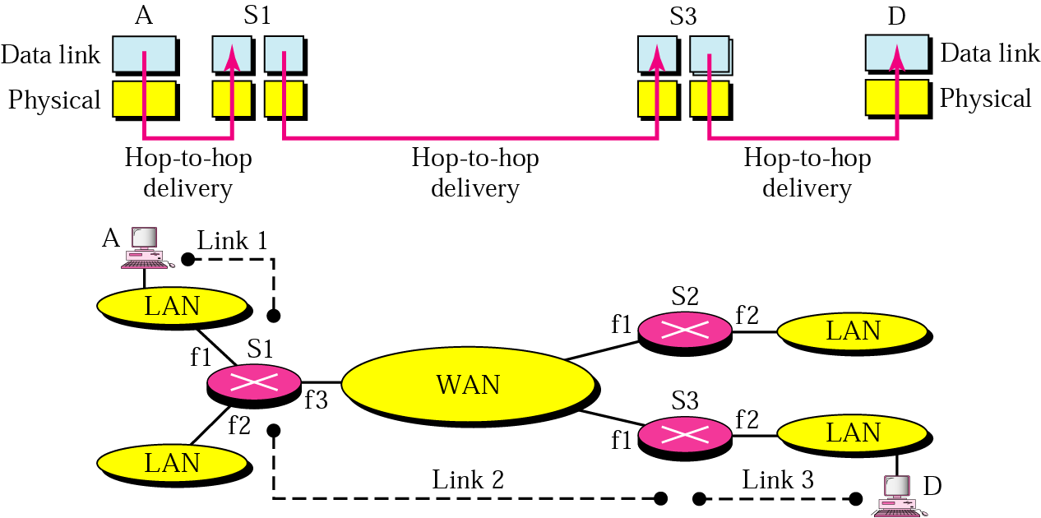
Figure 19.2 Links in an internetwork
From A to D, 3 networks should be passed.
Since MAC layer can reach next-hop only,
how could we deliver?

Slide 9
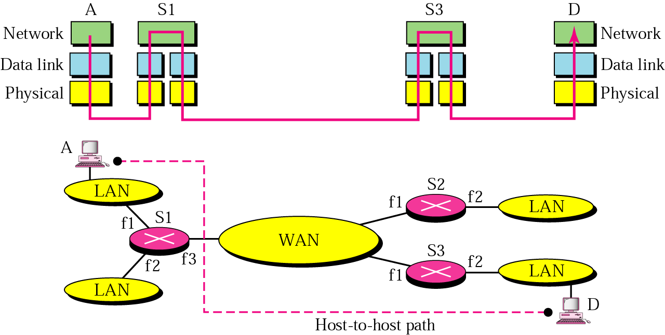
Figure 19.3 Network layer in an internetwork
Network (internetwork) layer on top of MAC layer

Slide 10
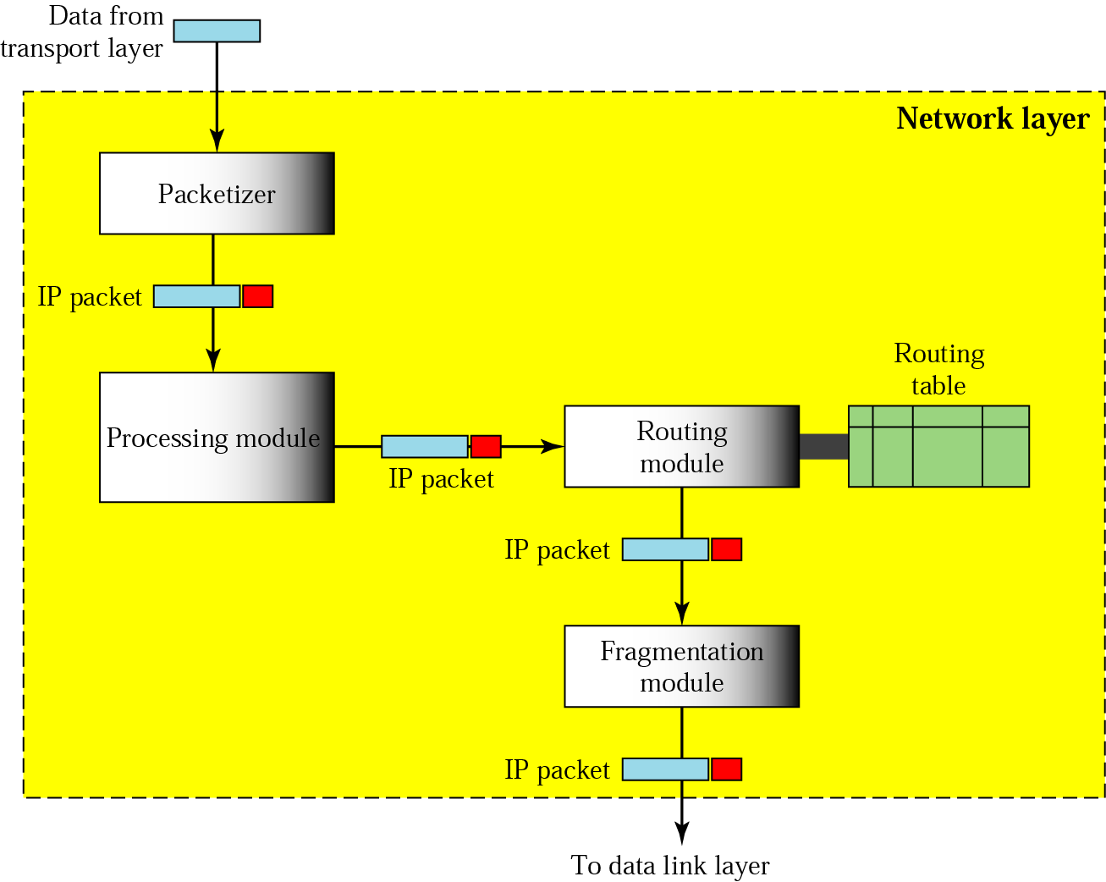
Figure 19.4 Network layer at the source
Unique at the source
The same as the router

Slide 11
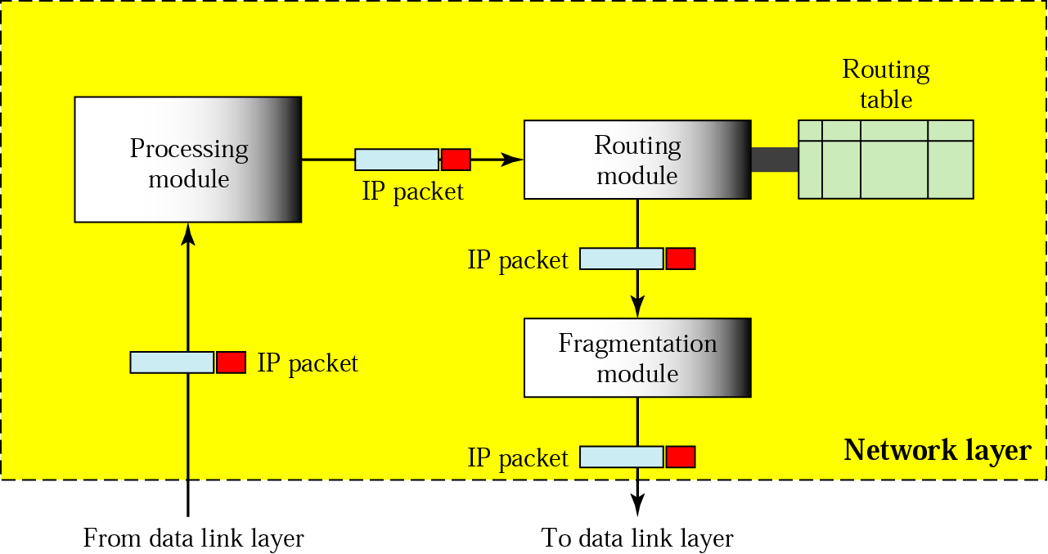
Figure 19.5 Network layer at a router
Initially, a UNIX machine was, and can still be used as a router

Slide 12
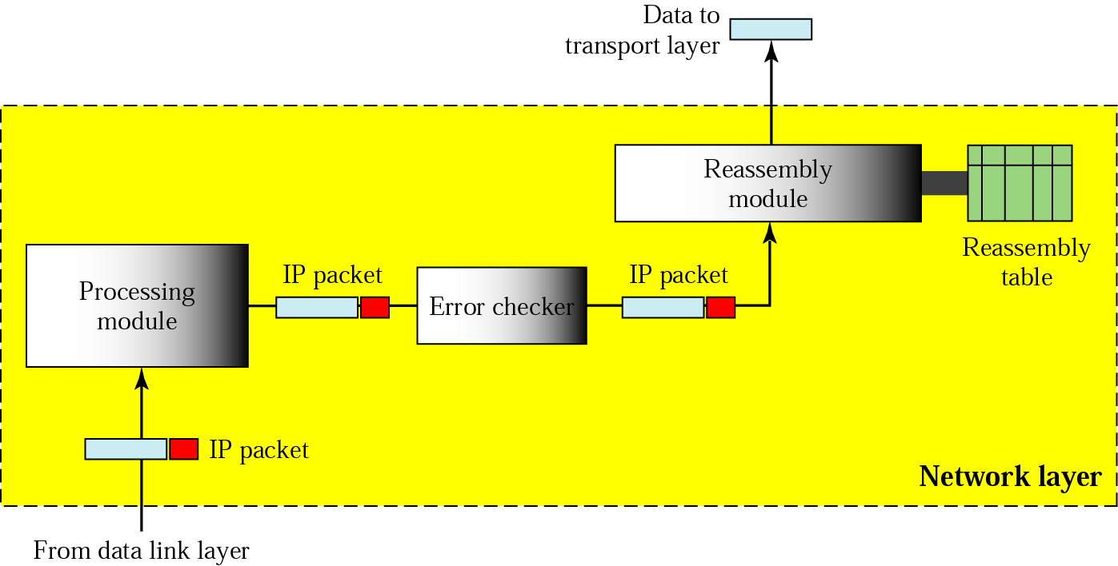
Figure 19.6 Network layer at the destination

Slide 13
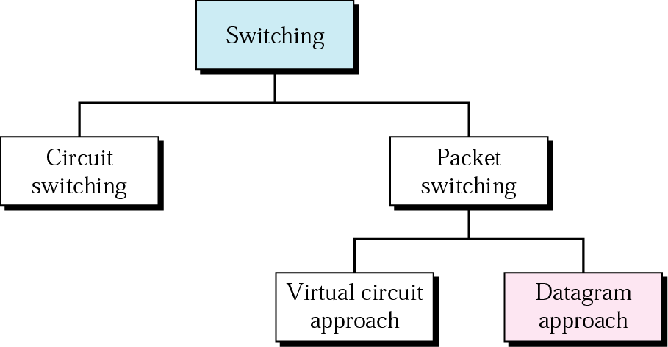
Figure 19.7 Switching

Slide 14
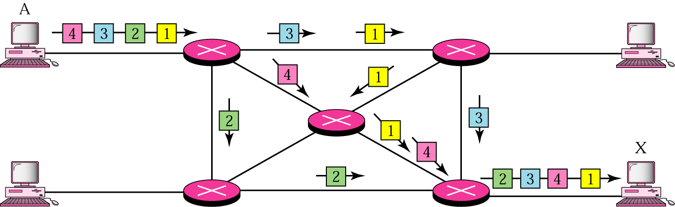
Figure 19.8 Datagram approach
While packets are received in order in circuit switching,
datagram approach can result in out-of-order packet arrival
Need for packet reordering capability at the destination
The Internet adopts the datagram approach

Slide 15

Note:
Switching at the network layer in the Internet is done using the datagram approach to packet switching.

Slide 16
Note:
Communication at the network layer in the Internet is connectionless.

Slide 17
19.2 Addressing
Internet Address
Classful Addressing
Subnetting
Supernetting
Classless Addressing
Dynamic Address Configuration
Network Address Translation

Slide 18
Note:
An IP address is a 32-bit address.

Slide 19
Note:
The IP addresses are unique
and universal.

Slide 20
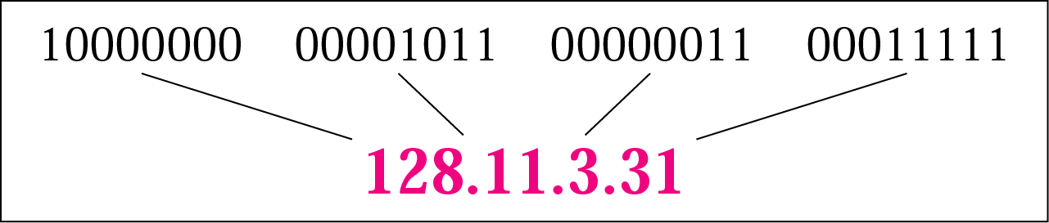
Figure 19.9 Dotted-decimal notation

Slide 21
Note:
The binary, decimal, and hexadecimal number systems are reviewed in Appendix B.

Slide 22
Example 1
Change the following IP addresses from binary notation to dotted-decimal notation.
a. 10000001 00001011 00001011 11101111
b. 11111001 10011011 11111011 00001111
Solution
We replace each group of 8 bits with its equivalent decimal number (see Appendix B) and add dots for separation:
a. 129.11.11.239
b. 249.155.251.15

Slide 23
Example 2
Change the following IP addresses from dotted-decimal notation to binary notation.
a. 111.56.45.78
b. 75.45.34.78
2
111
2
55
1
2
27
1
2
13
1
6
2
1
Solution
2
0
3
1
1
We replace each decimal number with its binary equivalent (see Appendix B):
a. 01101111 00111000 00101101 01001110
b. 01001011 00101101 00100010 01001110

Slide 24
Note:
In classful addressing, the address space is divided into five classes: A, B, C, D, and E.

